Slide 1

REAL ESTATE
Sprint 1&2

Slide 2
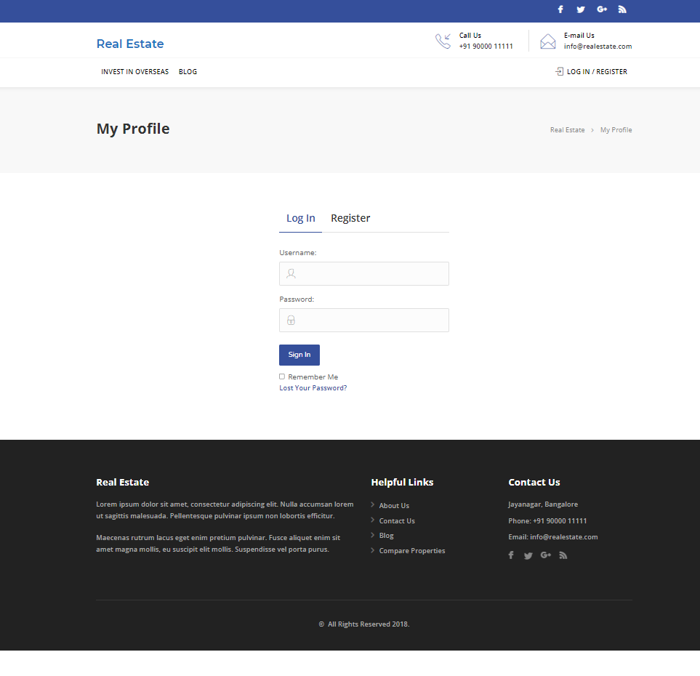
Real Estate website
Welcome to Real Estate

Slide 3
Manual Testing
Activities
Planning-User stories in Jira
Work allocation- For test design to team members- Jira tasks
Test design process-
Scenarios- categorised based on business risks
Test cases- positive and negative based testcases
Pre-conditions and specification for data creation
Test design techniques applied where ever necessary
Review process and baseline of testcases

Slide 4
Manual Testing - Sprint 1
Admin comment and user bookmark functionalities was assigned by scrum master.
Stories and task for admin comments and user bookmark was created in Jira.
Test cases for admin comments and user bookmark created in excel.
Test cases were reviewed and executed.
Defects and issues which were found during the execution of test cases and were noted down during cycle 1 and cycle 2.
Bugs were created in Jira.

Slide 5
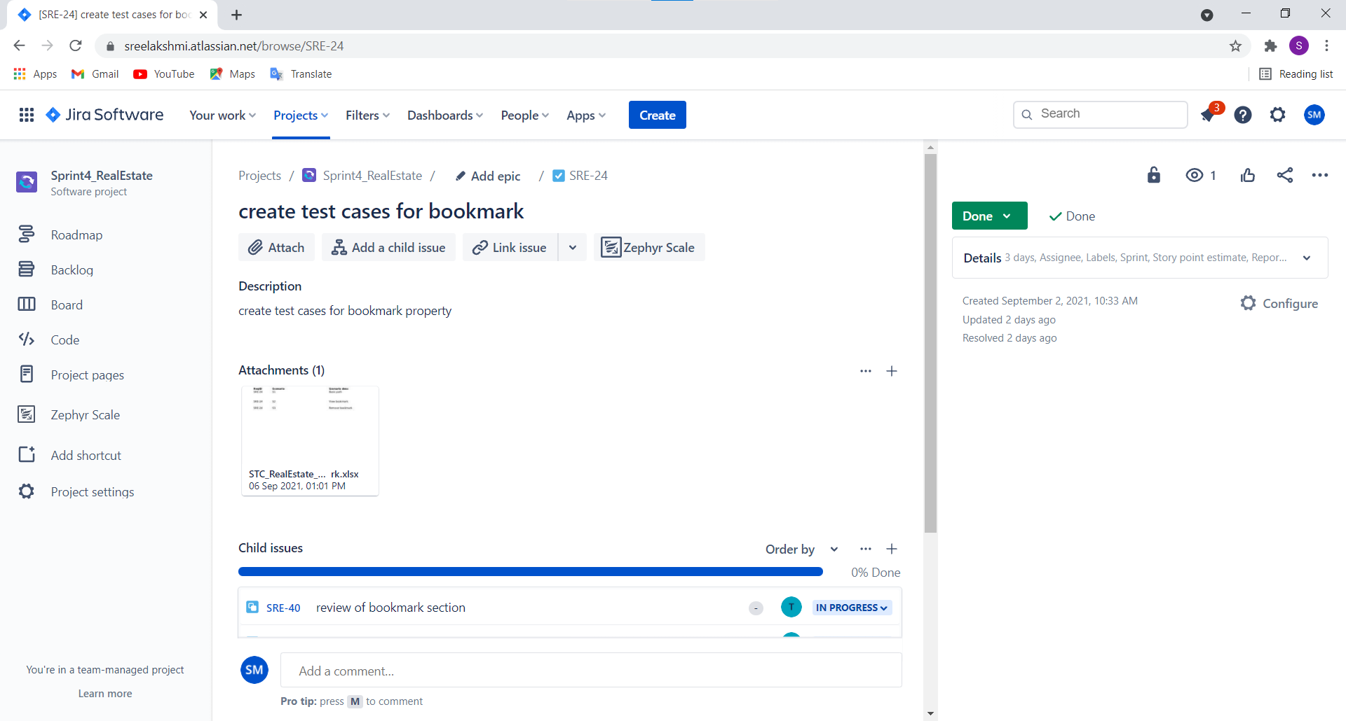
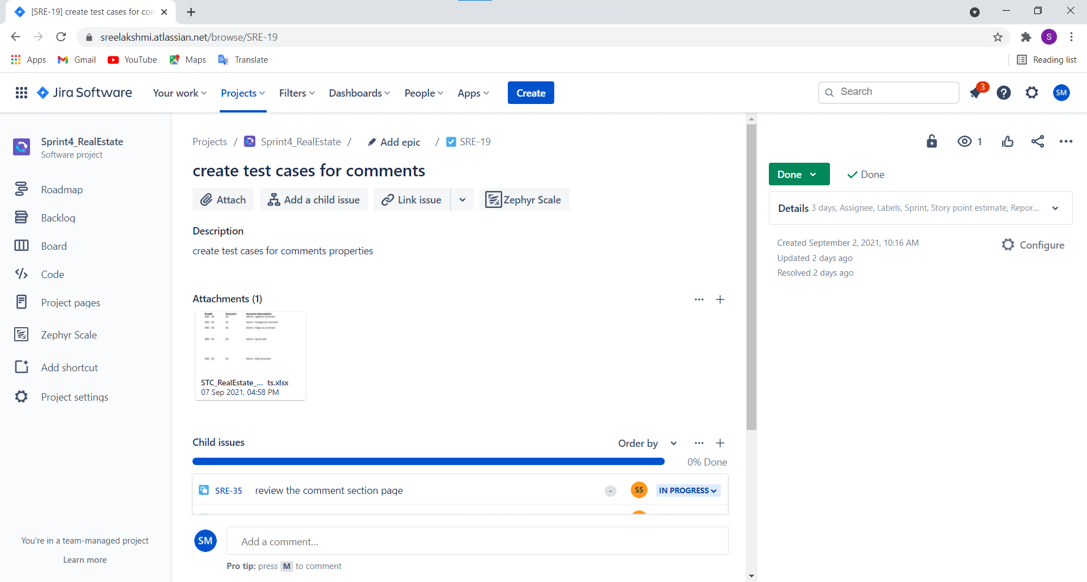
Task for admin comment and user bookmark in Jira

Slide 6
Automation Testing – Sprint 2
ADMIN
1.Smoke Test- Admin Comments
Smoke test is done using Selenium IDE
Created project in Selenium IDE
Gave the URL of the website
Started recording
Asserted the destination element
Stopped recording
Scripts will be generated
Ran the script

Slide 7
Automation Testing – Sprint 2
USER
1.Sanity Test – User Profile​
2.Sanity Test – Remove Bookmark​
Automation of user profile and remove bookmark was done using eclipse
Selenium , Java ,Maven, TestNG, Page Object Model, frameworks selected for the automation
Created separate package for Page Class and Testcase Class to implement Page Object Model
In page class reference to the web element is given using id/Xpath/CssSelector
TestNG reports were generated

Slide 8
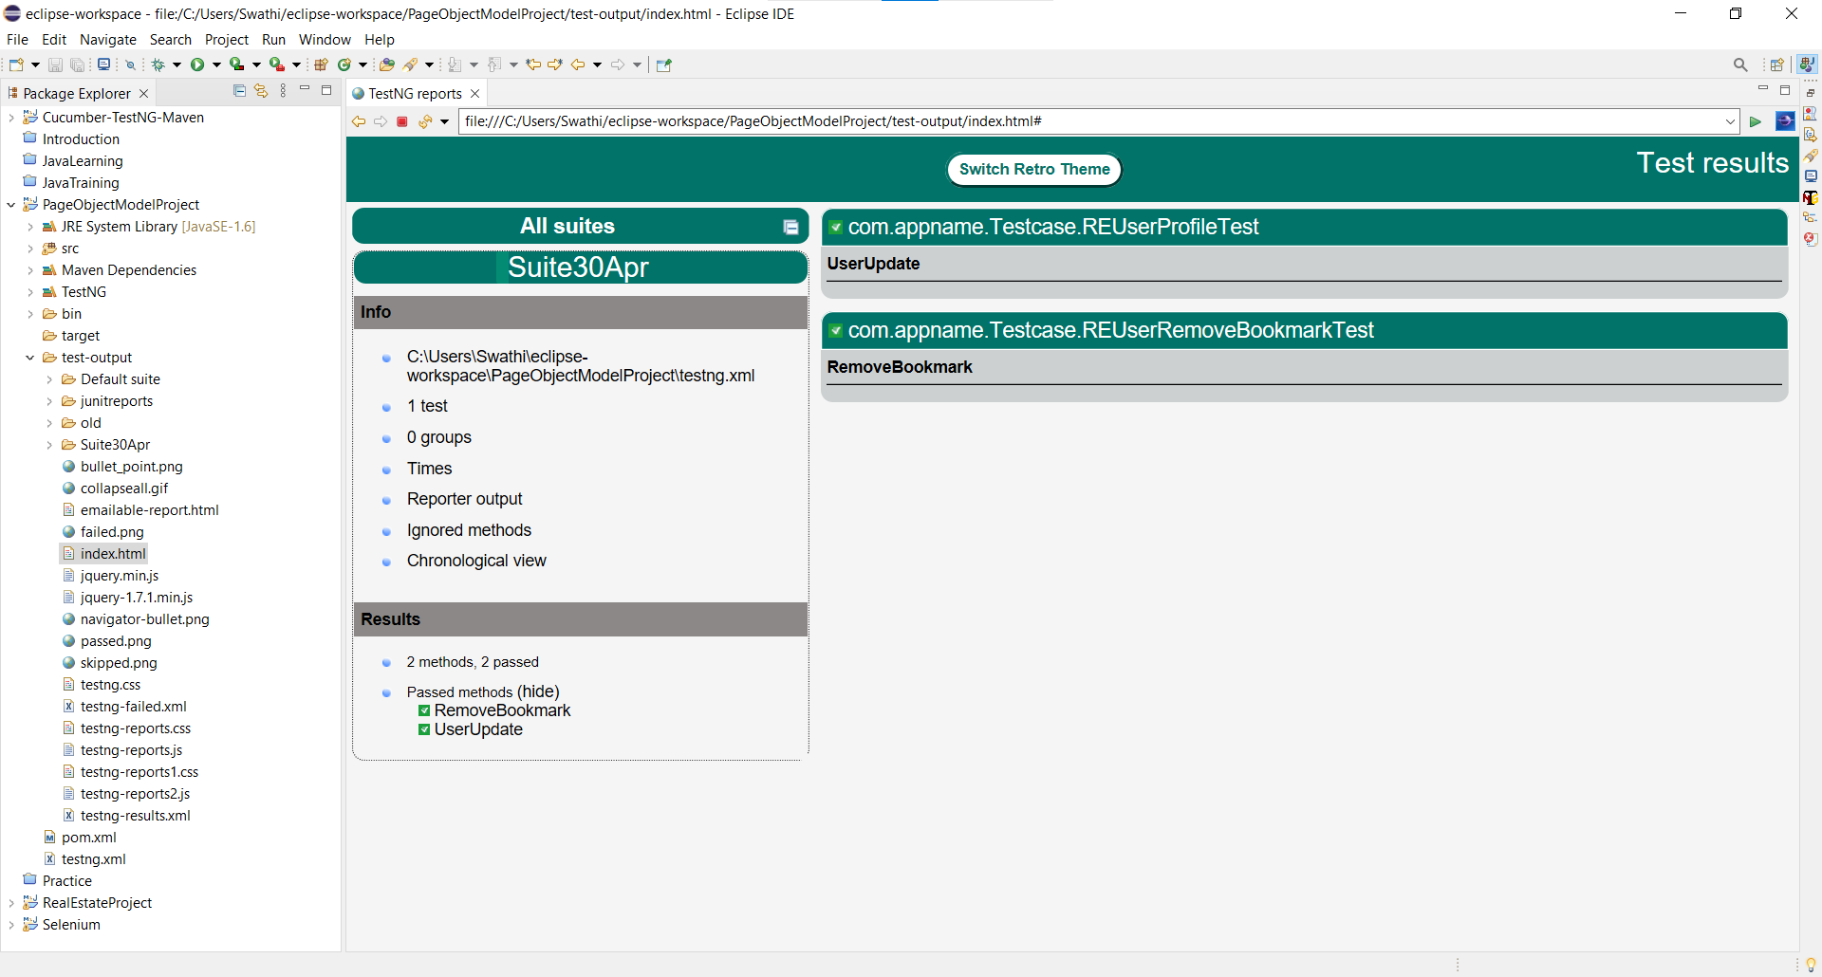
Test NG Report

Slide 9
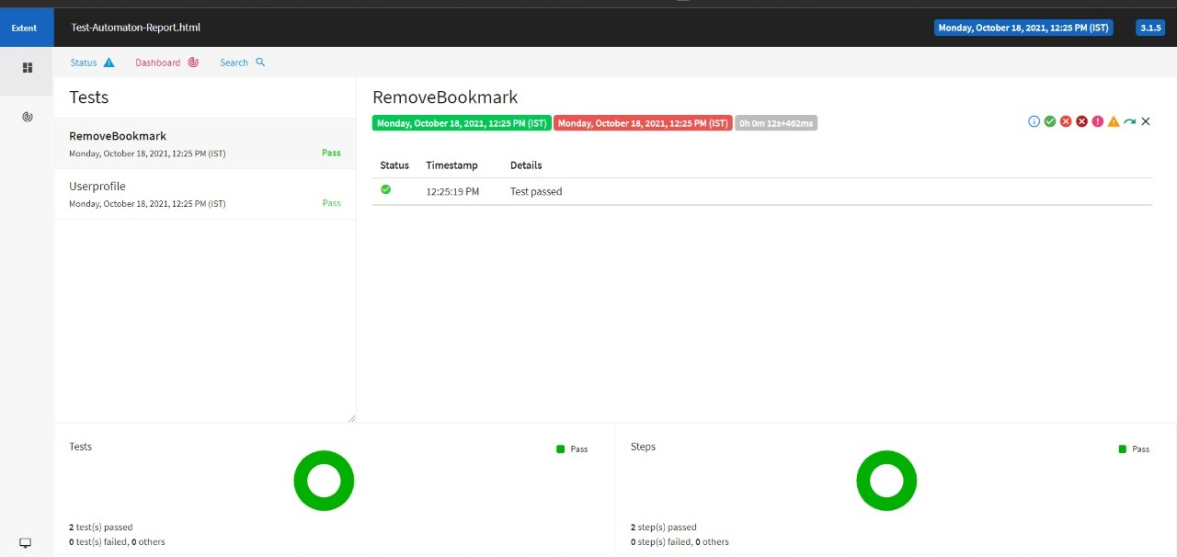
Extent Report

Slide 10
THANK YOU

